Slide 1
Neural Networks
Pauline Dang

Slide 2
Intro to Deep Learning
DL is a type of machine learning that uses algorithms to draw conclusion based on input data
Learns from representative examples
Advantages
Can identify patterns and anomalies in large volumes of raw data which lets it deliver accurate and reliable analysis results
Doesn’t need human expertise. Allows developers to identifies patterns that they may not even know that they are looking for
Disadvantages
Large amounts of quality data is resource consuming to collect and maintain
It cannot provide reasons for its conclusions
Very costly

Slide 3
Neural Networks and its Components
A NN is a structure of the human brain modeled on the computer
Consists of neurons and synapses organized into layers
Components
Neurons- A basic unit of neural networks that receives information, performs basic calculations, and passes it further
Synapses and weights- What connects the neurons and each has a weight
Results of neurons with greater weight will be more prominents in the next neuron
Bias - Allows for more variations of weights to be stored
Not always required but is more often than not included

Slide 4
How Neural Networks Work
Every neuron processes input data to extract a feature
Each neuron has its own weights and so each feature is weighted
Weights of each neuron is determined during the training of the network
Every network has an activation function and the combination of the activation function is described by a common function F

Slide 5
Training an Algorithm
Delta is the difference between the data and the output of the neural network
Then through repeating optimization, we try to lower the delta to zero, or close to it
Once delta is 0, the model is able to correctly predict example data

Slide 6
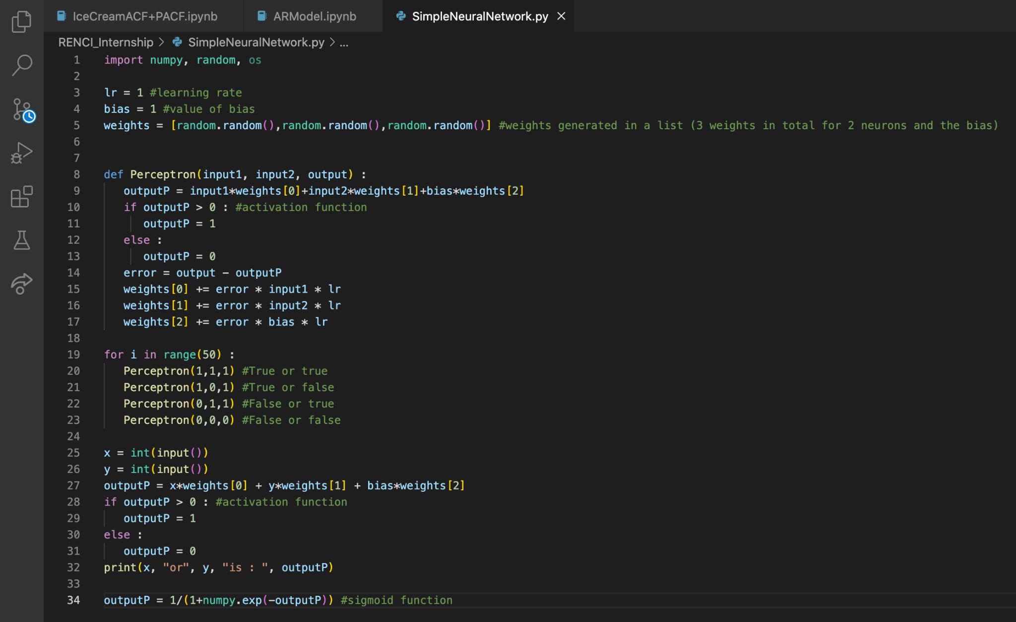
Making a simple Neural Network in Python

